Slide 1

Natural Language Processing
Yue Zhang
Westlake University

Slide 2
Overview
Week 2
Overview of NLP architecture
Data and Model
Review of background
Linear Models
Week 3
Week 4
Week 5
Week 6
Week 7
N-gram Language Models
Naïve Bayes
Generative Text Classification
Features
Document Representation
Discriminative Text Classification
Neuron
SGD
Entropy, Perplexity
Word Representation
HMM -- Generative Sturctured Prediction
CRF – Discriminative Structured Prediction
Neural Models
Week 8
Week 10
Week 12
MLP, Multi-Layer Perception
Neural N-gram LM and Word Embedding
Neural Structured Prediction
Sequence-to-sequence
Neural Recurrent Language Models
Week 9
Week 13
Sequence Representation
Neural Text Classification
Week 11
Sequence-level Pre-training
Pre-trained Models for Text Classification and other MLP tasks
Structured Representation
Large Language Models
Week 14
Week 15
Scaling, instruction following and LLMs
LLMs for NLP, AGI and beyond

Slide 3
Week 1
Introduction

Slide 4
Contents
1.1 What is Natural Language Processing (NLP)?
1.2 NLP tasks
1.2.1 Computational Linguistic tasks
1.2.2 Information Extraction tasks
1.2.3 Natural Language Generation
1.2.4 Related Fields
1.3 NLP from a Machine Learning Perspective

Slide 5
Contents
1.1 What is Natural Language Processing (NLP)?
1.2 NLP tasks
1.2.1 Computational Linguistic tasks
1.2.2 Information Extraction tasks
1.2.3 Natural Language Generation
1.2.4 Related Fields
1.3 NLP from a Machine Learning Perspective

Slide 6

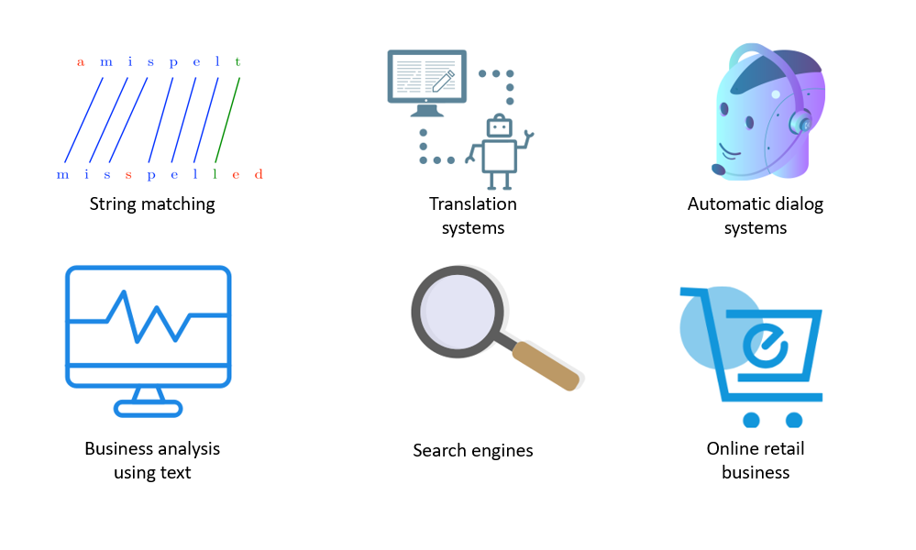
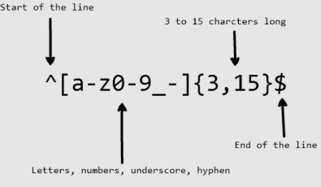


What is NLP?
In the broadest sense, NLP refers to any program that automatically processes human languages
Regular expression
String matching
Translation systems
Deepseek
Business analysis using text
Search engines
ChatGPT
Sora

Slide 7
Contents
1.1 What is Natural Language Processing (NLP)?
1.2 NLP tasks
1.2.1 Computational Linguistic tasks
1.2.2 Information Extraction tasks
1.2.3 Natural Language Generation
1.2.4 Related Fields
1.3 NLP from a Machine Learning Perspective

Slide 8
Fundamental Tasks
Phonology
Morphology
Syntax
Semantics
Discourse
Pragmatics
Computational Linguistics
AI
Linguistics

Slide 9
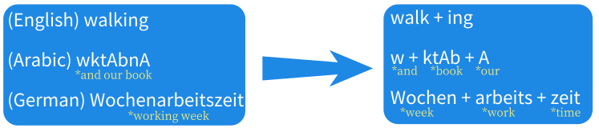

Syntactic tasks: Word level
Morphological analysis
Word segmentation

Slide 10

Syntactic tasks: Word level
Tokenization
POS Tagging

Slide 11
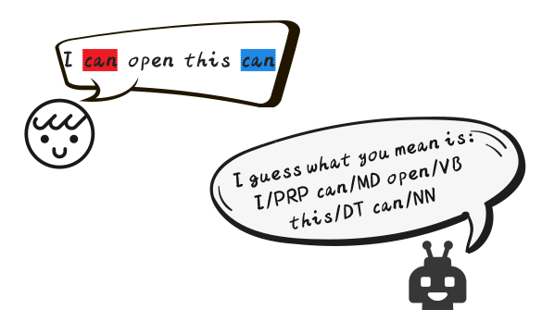
Syntactic tasks: Word level
Part-of-speech (POS)
Basic syntactic role that words play in a sentence

Slide 12
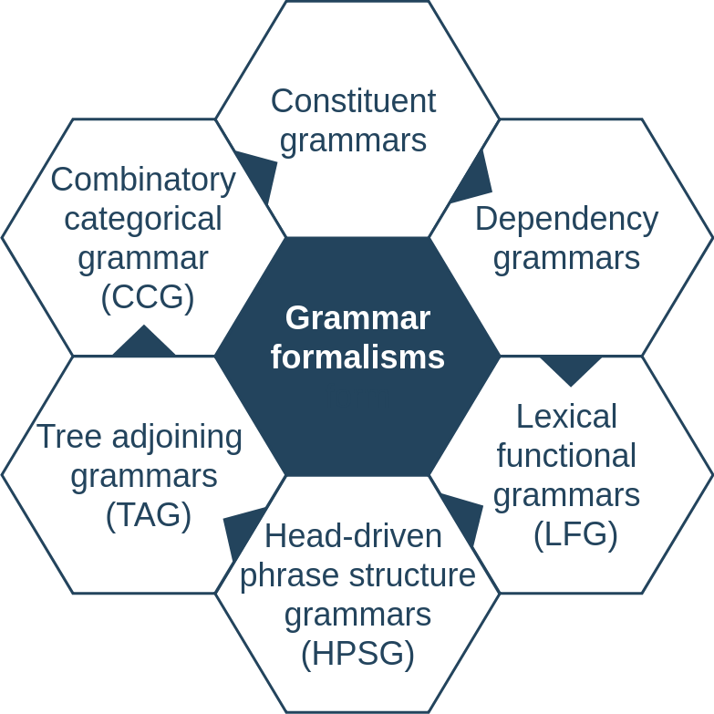
Syntactic tasks: Sentence level
Grammar formalisms for syntactic parsing:

Slide 13
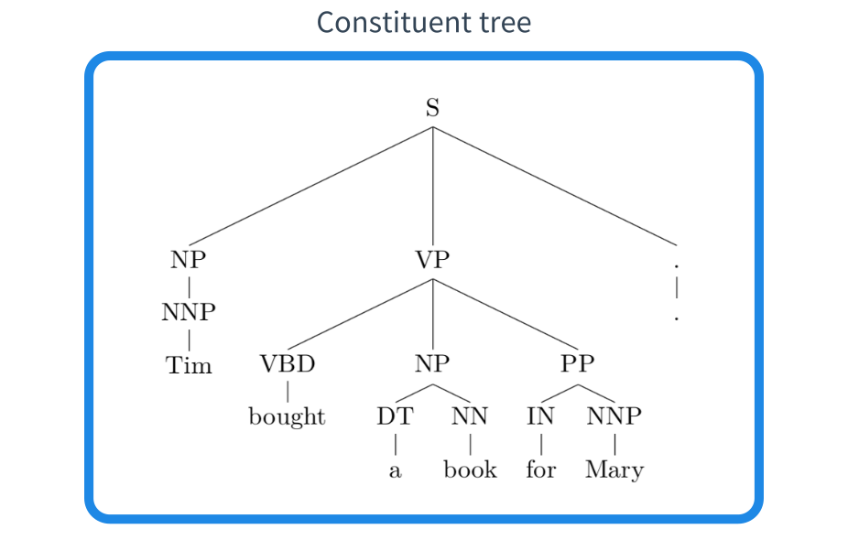
Constituent parsing
Constituent parsers assign phrase labels to constituent, also referred to as phrase-structure grammars.

Slide 14
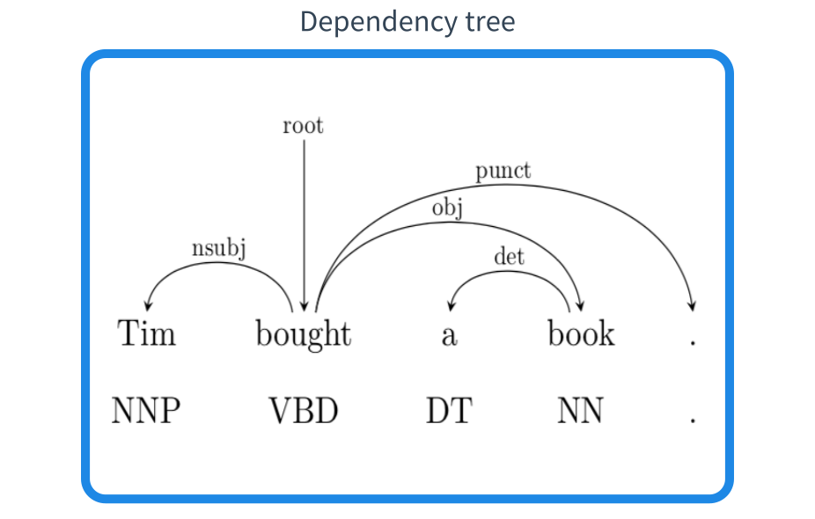
Dependency parsing
Dependency parsers analyze a sentence in head words and dependent words.

Slide 15
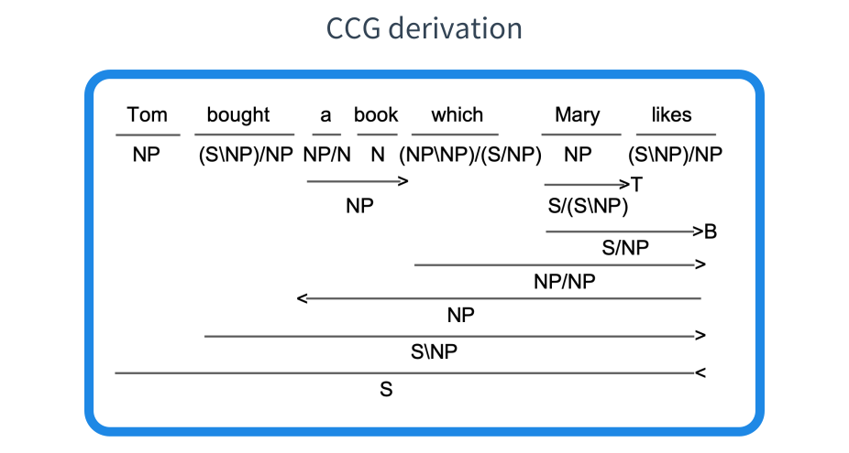
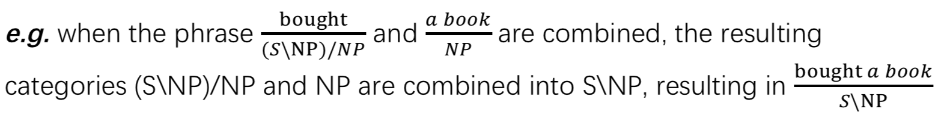
CCG parsing
Lexical categories (e.g. NP, N, S\NP)
Composition rules

Slide 16
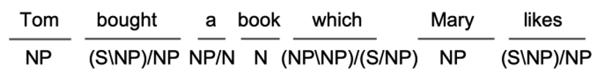
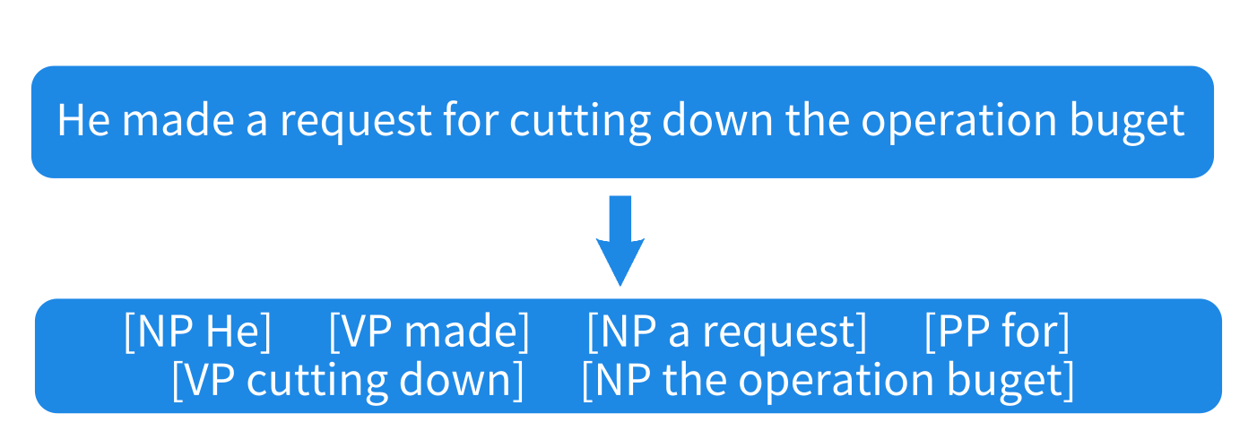
Shallow Parsing
Also called shallow parsing, a pre-processing step before parsing.
CCG supertagging
Syntactic chunking
identify basic syntactic phrases from a given sentence.

Slide 17
Semantic tasks: Word level
Word sense disambiguation (WSD)
Never trouble troubles till trouble troubles you.
I saw a man saw a saw with a saw.
Metaphor
Love is a battlefield.
Bob is a couch potato.

Slide 18
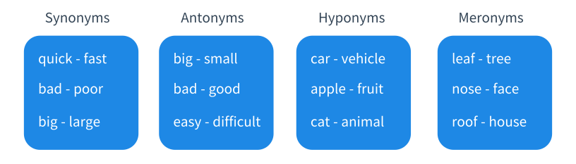
Semantic tasks: Word level
Sense relations between words
Analogy
king – queen / man – woman / boy – girl

Slide 19
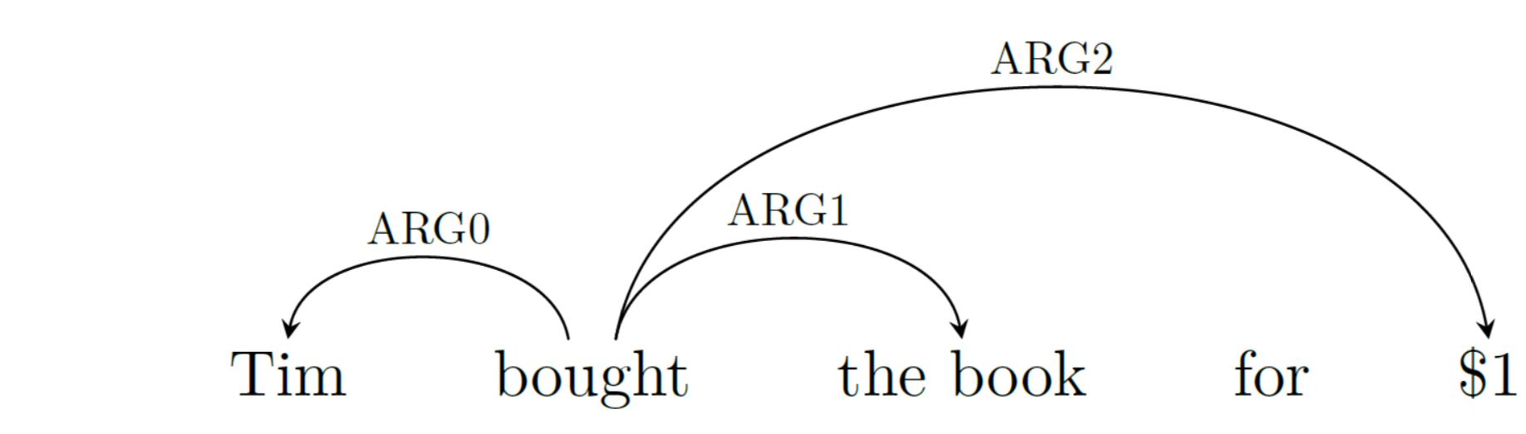
Semantic tasks: Sentence level
Predicate-argument relations (semantic role labeling)
Tim bought this book for $1.

Slide 20
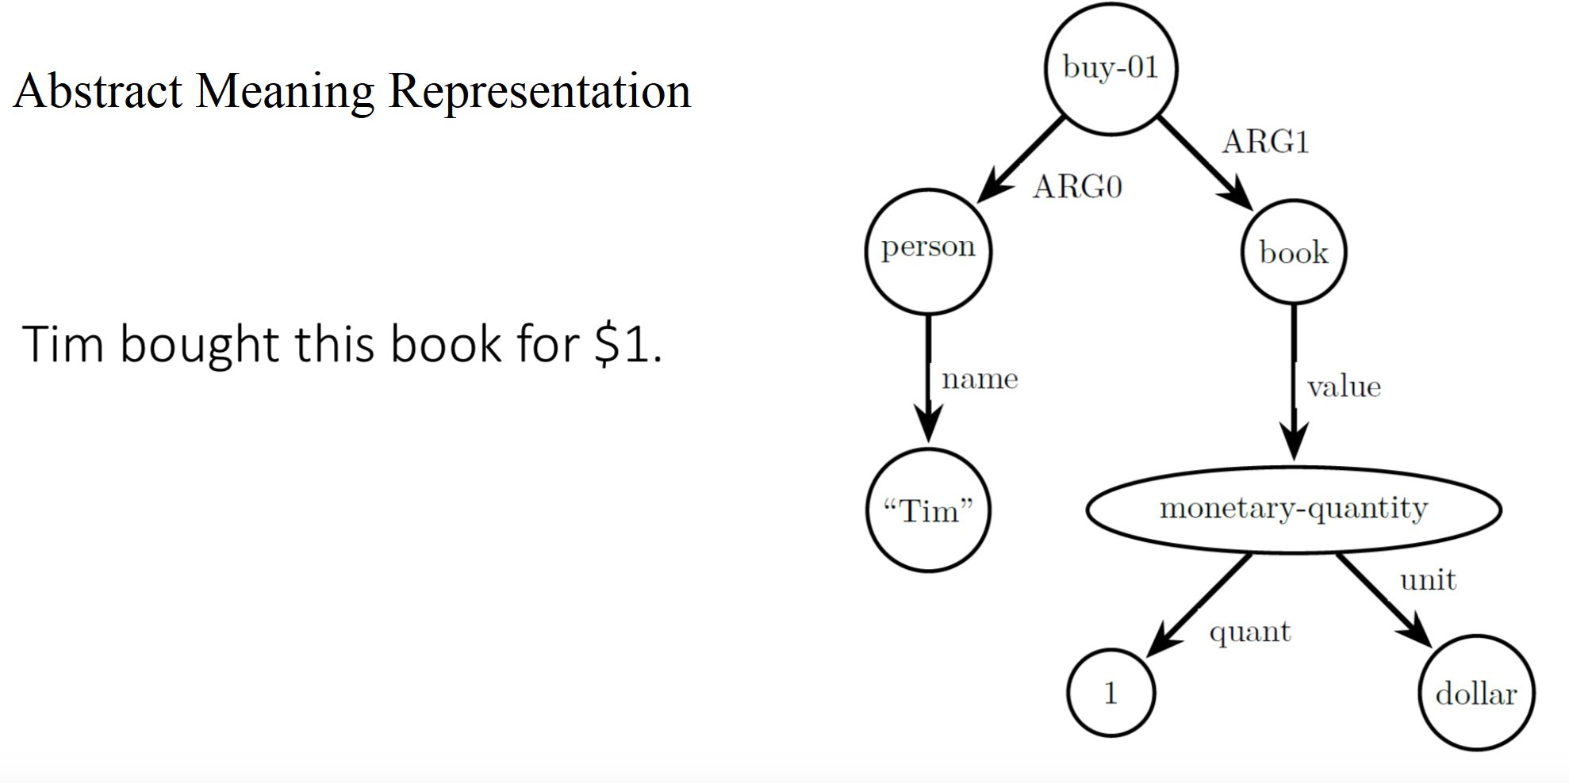
Semantic graphs
Abstract Meaning Representation
Tim bought this book for $1.

Slide 21
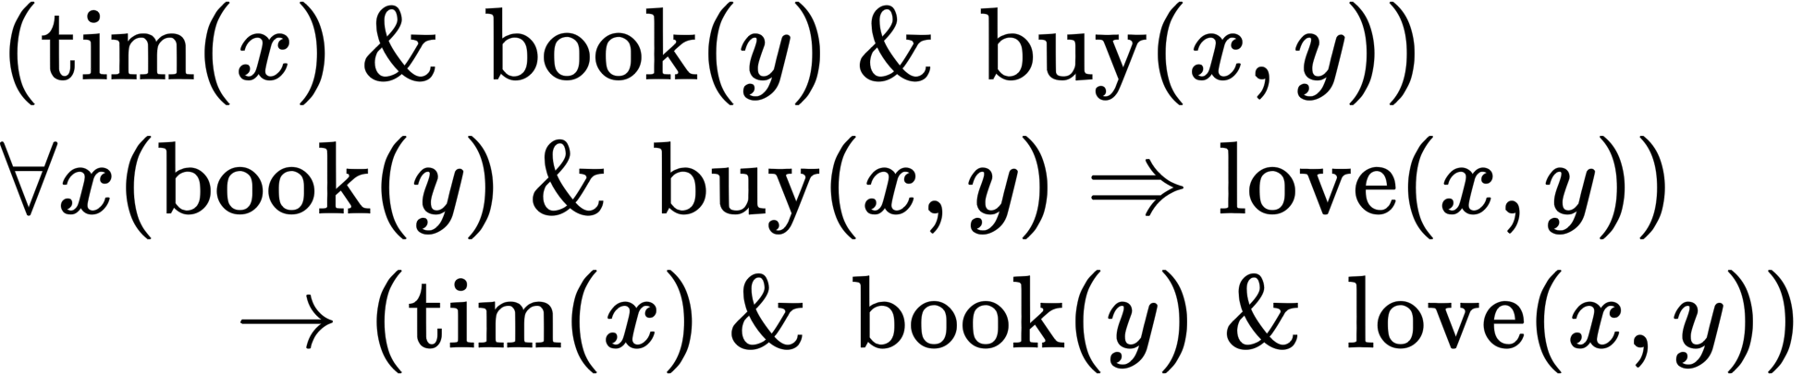
Logic
“Everyone who bought this book loves it.”
“Tim bought this book.”,
We can infer that “Tim loves this book.”

Slide 22
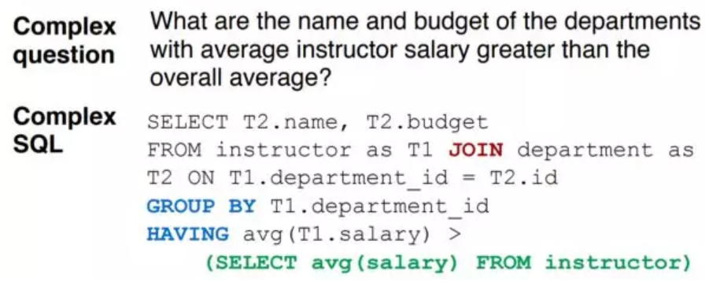
More Semantic Parsing Cases
Text to SQL

Slide 23
Text entailment
Natural Language Inference (NLI)
a directional semantic relation between two texts
Premise: Tim went to the Riverside for dinner
Hypotheses1: The Riverside is an eating place ------------ True
Hypotheses2: Tim had dinner --------------------------------- True
Hypotheses3: Tom had lunch --------------------------------- False
Hypotheses4: Tim did not have dinner ----------- Contradiction

Slide 24
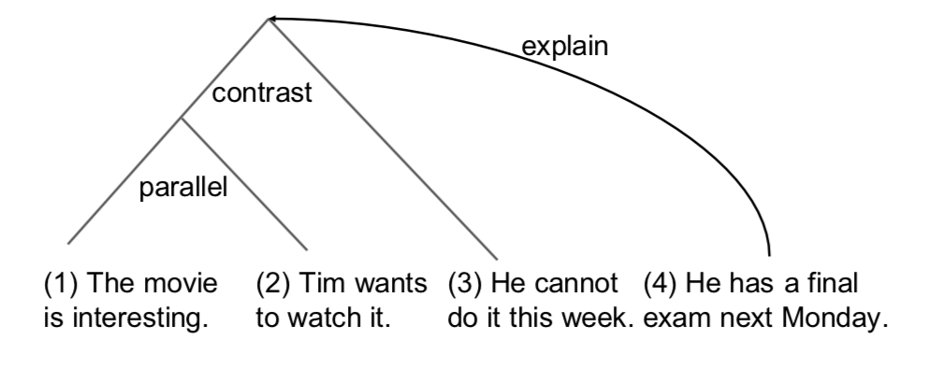
Discourse tasks
Discourse: multiple sub-topics and coherence relations
Discourse parsing: Analyze the coherence relations between sub-topics in a discourse. Rhetoric structure theory

Slide 25
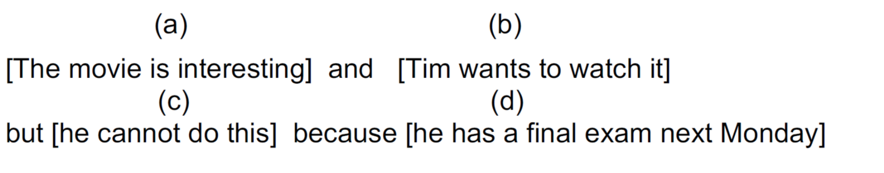

Discourse segmentation

Slide 26
Contents
1.1 What is Natural Language Processing (NLP)?
1.2 NLP tasks
1.2.1 Computational Linguistic tasks
1.2.2 Information Extraction tasks
1.2.3 Natural Language Generation
1.2.4 Related Fields
1.3 NLP from a Machine Learning Perspective

Slide 27
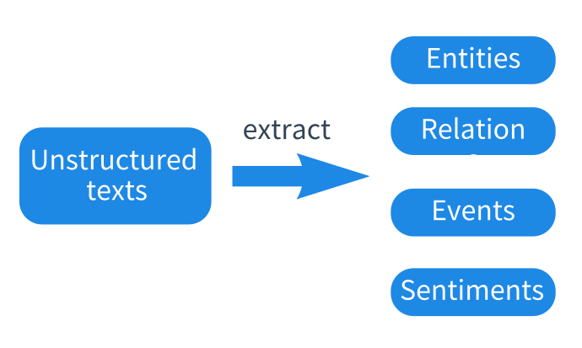
Information extraction (IE)
Obtain structured information from unstructured texts.
Automatic monitory of news and social media
Understanding of patent and scientific articles

Slide 28
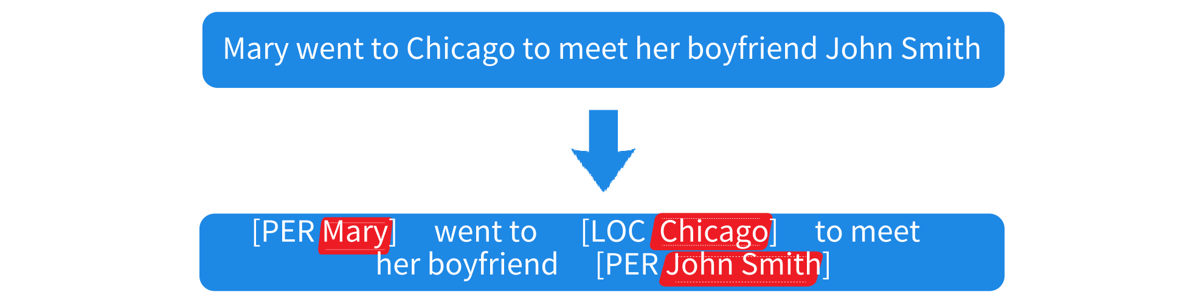
Entities
Named entity recognition (NER)
To identify all named entity mentions from a given piece of text

Slide 29


Anaphora Resolution
resolves what a pronoun or noun phrase refers to
Zero-pronoun resolution
detects and interprets dropped pronouns

Slide 30
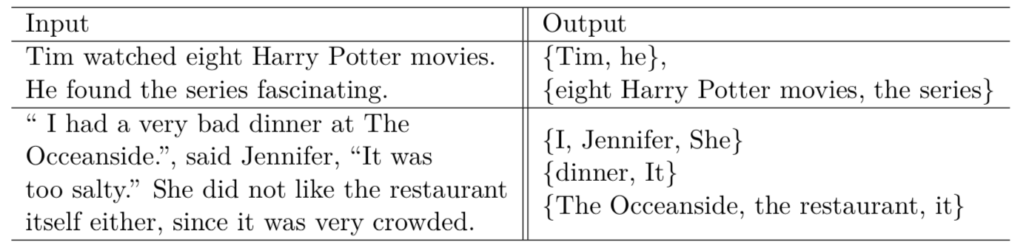
Co-references
Co-reference resolution
finds all expressions that refer to the same entities in a text

Slide 31

Relations
Relations between entities represent knowledge
common relations
hierarchical
domain-specific

Slide 32
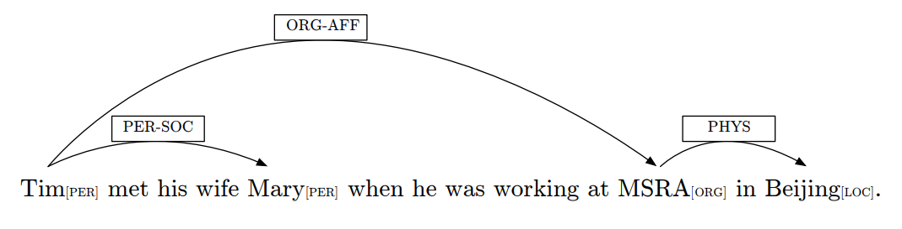
Relations
Relation extraction
identify relations between entity under a set of pre-specified relation categories.

Slide 33
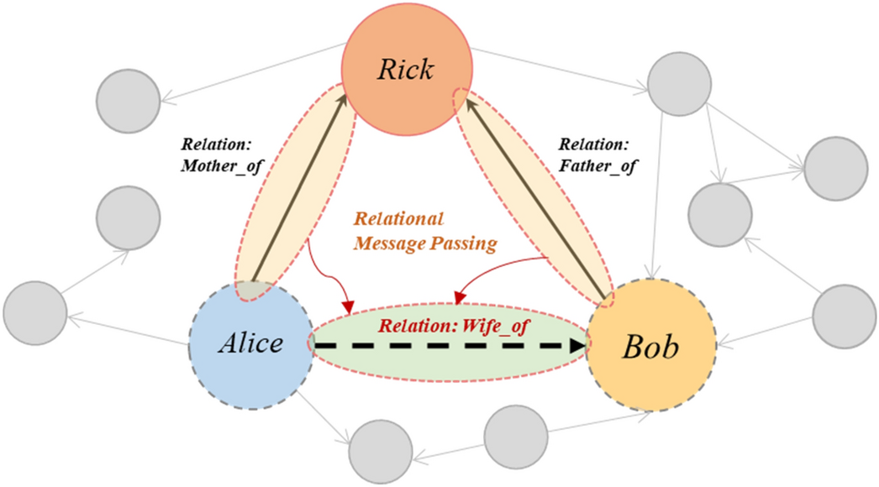
Knowledge graph
a type of databases, entities form nodes and relations form edges.

Slide 34

Knowledge graph
Entity linking (entity disambiguation)
determines the identity of entity mentioned from text.
Related task: Named entity normalization
finds a canonical term for named entity mentions

Slide 35
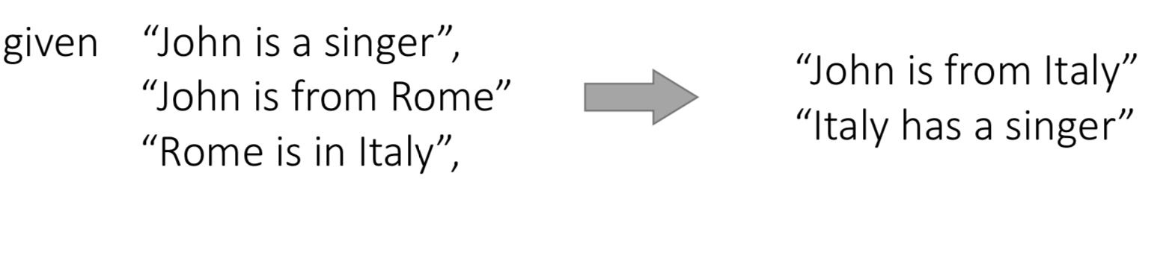
Knowledge graph
No knowledge graph is complete !
Link prediction (knowledge graph completion)
Knowledge graphs allow knowledge inference.

Slide 36
Events
Event Detection
Trigger word: “Trump visited Tokyo.”
“Trump’s Tokyo visit has finished.”
Event type classification
“DIPLOMATIC VISIT”
Argument extraction
“VISITOR=Trump”

Slide 37
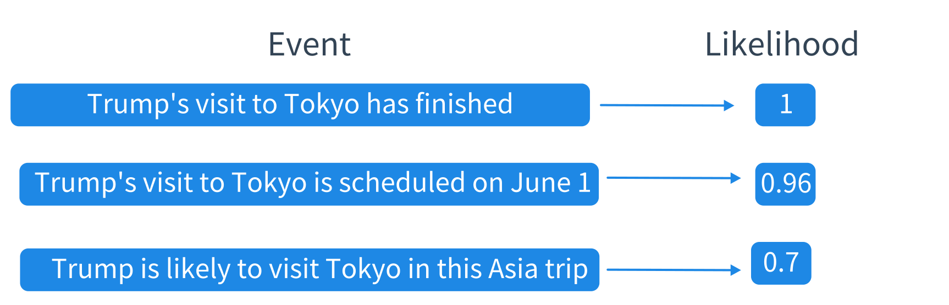
Events
News event detection (first story detection)
Event factuality prediction (predict the likelihood of event)
Event time extraction (e.g. temporal ordering of events)
Causality detection

Slide 38
Events
Event coreference resolution
“I interviewed Mary yesterday. It went very smooth.”
“it” refers to the interviewing event
Zero-pronouns
" Mary went to Russia to see the World Cup. Tom too." verb phrase ellipsis

Slide 39
Events
Script learning
aims to extract a set of partially ordered events knowledge
In the scenario "restaurant visiting"
"customer to be seated"
"customer to order food"
"waiter to serve food"
"customer to eat food"
"customer to pay"

Slide 40
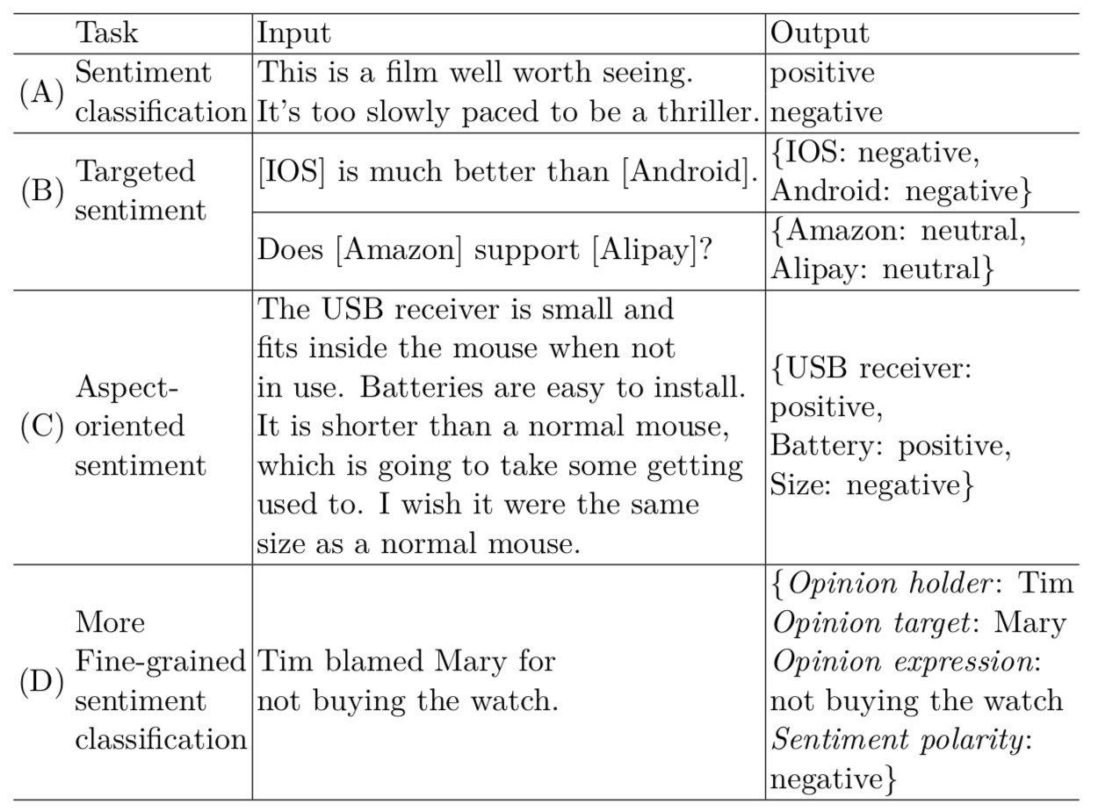
Sentiment analysis (opinion mining)

Slide 41
Sentiment analysis (opinion mining)

Slide 42
Sentiment analysis (opinion mining)

Slide 43
Sentiment analysis (opinion mining)

Slide 44
Sentiment related tasks
Sarcasm detection
"Like you care!“
Sentiment lexicon acquisition
lexicons that contain sentiment-baring words, polarities and strengths
Emotion detection
"anger","disappointed","excited"

Slide 45
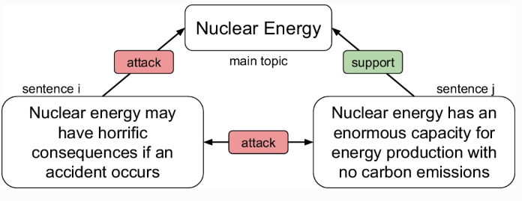
Sentiment related tasks
Stance detection and argumentation mining
"for","against“

Slide 46
Contents
1.1 What is Natural Language Processing (NLP)?
1.2 NLP tasks
1.2.1 Computational Linguistic tasks
1.2.2 Information Extraction tasks
1.2.3 Natural Language Generation
1.2.4 Related Fields
1.3 NLP from a Machine Learning Perspective

Slide 47
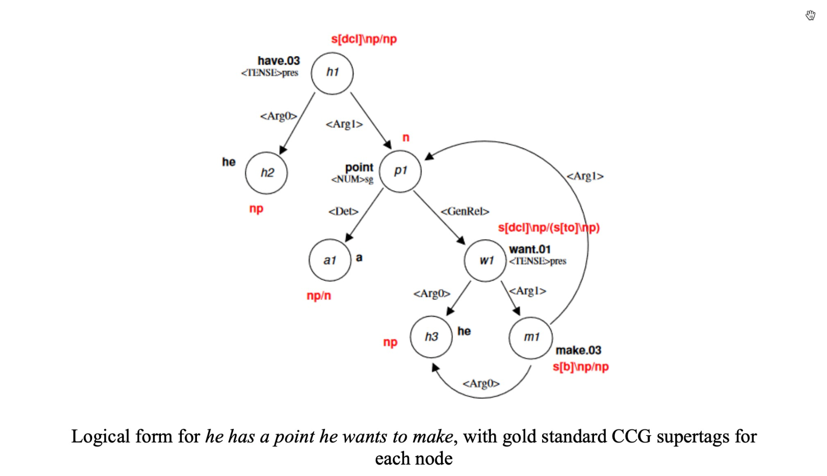
Realization
The generation of natural language text from syntactic/semantic representations
Semantic dependency graphs (logical forms) example:
CCG Realization with LSTM Hypertagging. Reid Jerry Fu, BS

Slide 48
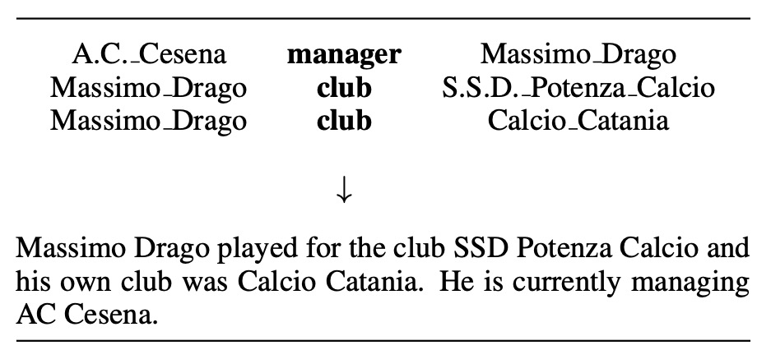
Data-to-text Generation
The generation of natural language text from syntactic/semantic representations
Semantic dependency graphs (logical forms) example:
Neural data-to-text generation: A comparison between pipeline and end-to-end architectures. Thiago Castro Ferreira et, al.

Slide 49
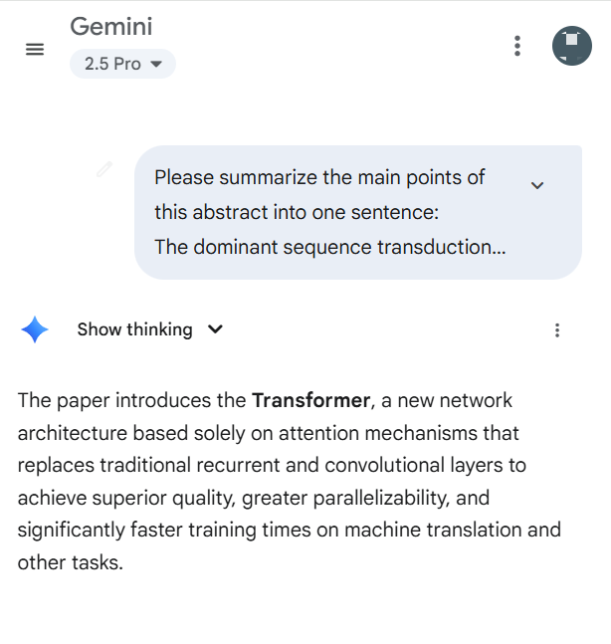
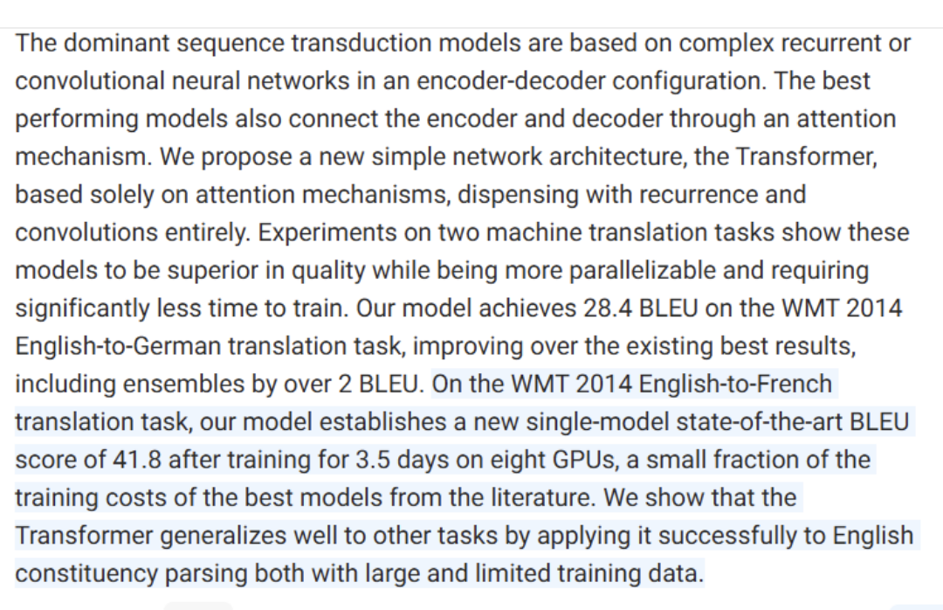
Summarization

Slide 50
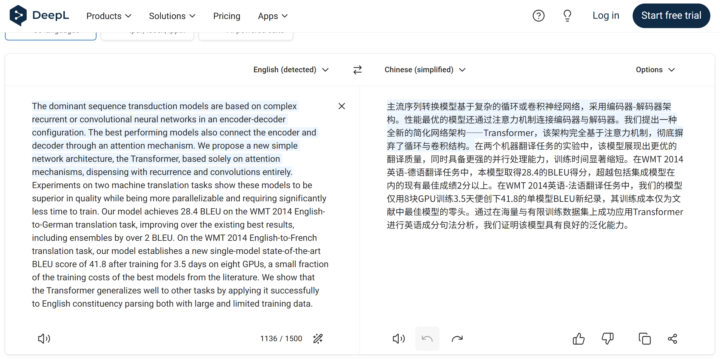
Machine translation

Slide 51
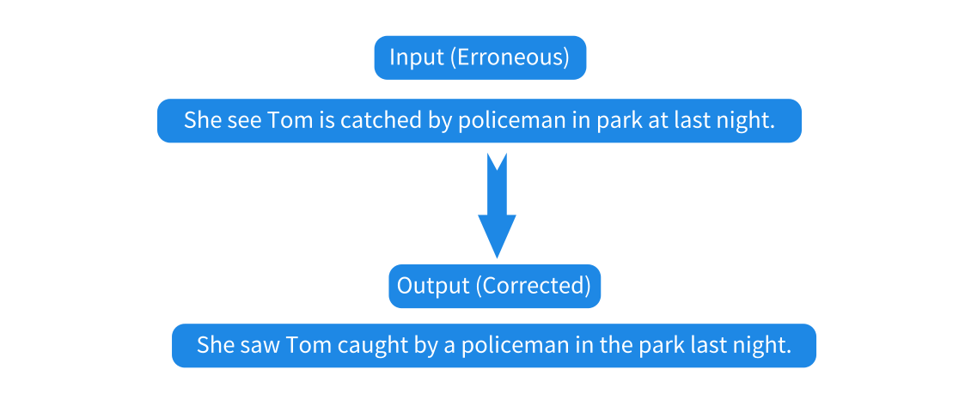
Grammar error correction
Grammar error detection
Disfluency detection
Writing quality assessment

Slide 52
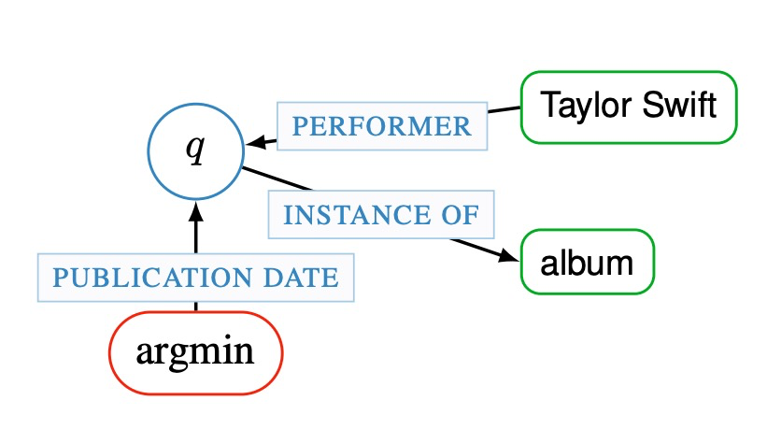
Question answering (QA)
Knowledge-base QA
A semantic graph for an example question “What was the first Taylor Swift album?”
Modeling Semantics with Gated Graph Neural Networks for Knowledge Base Question Answering. Daniil Sorokin et al.

Slide 53
Question answering (QA)
Reading comprehension (machine reading)
answer questions in interpretive ways
An example from the Stanford Question Answering Dataset (SQuAD):
Conventionally, a computer consists of at least one processing element, typically a central processing unit (CPU), and some form of memory. The processing element carries out arithmetic and logic operations, and a sequencing and control unit can change the order of operations in response to stored information. Peripheral devices allow information to be retrieved from an external source, and the result of operations saved and retrieved.
In computer terms, what does CPU stand for?
What are the devices called that are from an external source?
What are two things that a computer always has?
SQuAD: 100,000+ Questions for Machine Comprehension of Text. Pranav Rajpurkar et al.

Slide 54
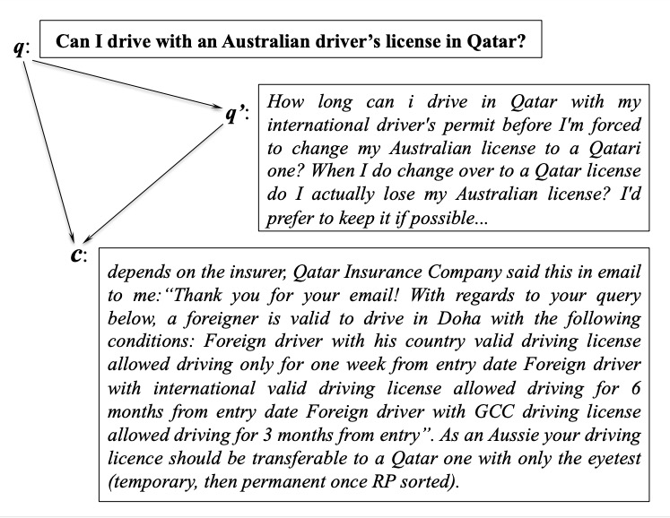
Question answering (QA)
Community QA
An example of Question Answering from website forum showing three pairwise interactions
Between the original question q, the related qustion q’, and a comment c in the related question thread.
SemEval-2017 Task 3: Community Question Answering. Preslav Nakov et al.

Slide 55
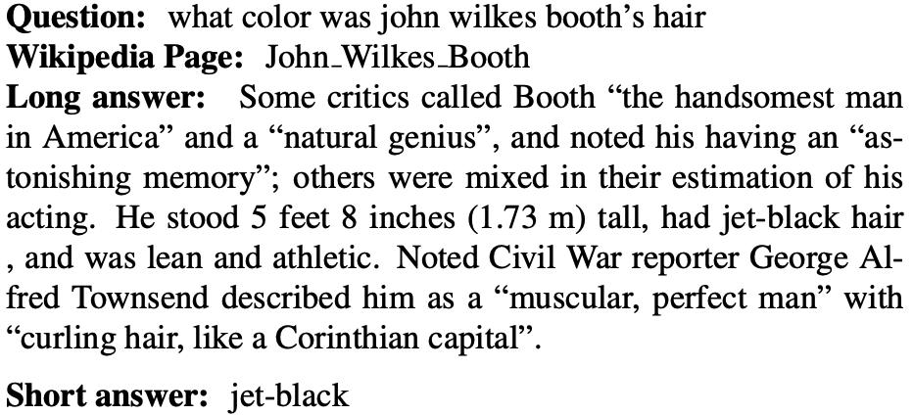
Question answering (QA)
Open QA
An example from the Natural Questions corpus:
Natural Questions: a Benchmark for Question Answering Research. Kwiatkowski et al.

Slide 56

Dialogue systems
Chit-chat
Task-oriented dialogues — ticket booking
Writing

Slide 57
Contents
1.1 What is Natural Language Processing (NLP)?
1.2 NLP tasks
1.2.1 Computational Linguistic tasks
1.2.2 Information Extraction tasks
1.2.3 Natural Language Generation
1.2.4 Related Fields
1.3 NLP from a Machine Learning Perspective

Slide 58
Information retrieval
Text classification / text clustering
Text topics classification
"finance","sports","Tech"...
Spam detection
email spam
Opinion spam detection
whether a review contains deceptive false opinions
Language identification
"French","English“
Rumor detection
false statement
Humor detection

Slide 59
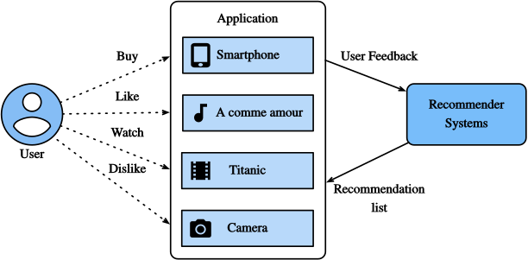
Recommendation system
leverage text reviews for recommending

Slide 60
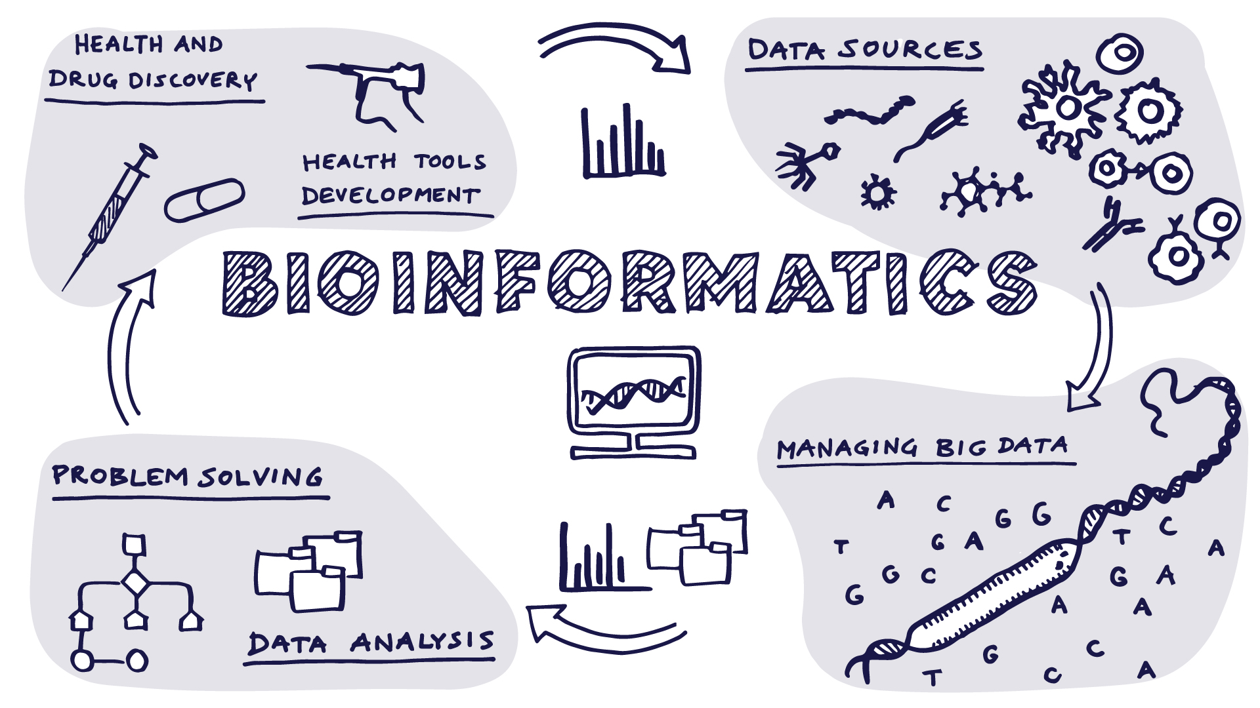
Bioinformatics

Slide 61
Text mining and text analytics
derive high-quality information from text
Clinical decision assistance
Stock market prediction
Movie revenue prediction
Presidential election results prediction

Slide 62


AGI and ASI
multi-modality
embodied AI

Slide 63
Contents
1.1 What is Natural Language Processing (NLP)?
1.2 NLP tasks
1.2.1 Computational Linguistic tasks
1.2.2 Information Extraction tasks
1.2.3 Natural Language Generation
1.2.4 Related Fields
1.3 NLP from a Machine Learning Perspective

Slide 64
Main approaches
Rule-based (symbolic) approach (1950s-1980s)
The oldest approaches to NLP
Based on human-developed rules and lexicons
Challenges in resolving ambiguities
"The spirit is strong, but the flesh is weak“
"The Vodka is good, but the meat is bad"

Slide 65
Main approaches
Statistical approach (traditional machine learning) (1980s-2000s)
Gradually adopted by both the academia and the industry
Using probabilistic modeling
training data (corpus with markup)
feature engineering
training a model on parameters
applying model to test data

Slide 66
Main approaches
Connectionist approach (Neural networks) (2000s-now)
Deep learning surpasses statistical methods as the domain approach
free from linguistic features
large neural network models

Slide 67
Main approaches
Pre-Training (2018-2022)
Using large text to train a language model, and then fine-tune it on a task
BERT
BART
RoBERTa
GPT

Slide 68
Main approaches
LLM (2023-now)
Using large text to train a foundation model
GPT 2, GPT 3, ChatGPT
T5, FLAN-T5
Claude, Mistral, Gemini
Deepseek, Qwen …

Slide 69
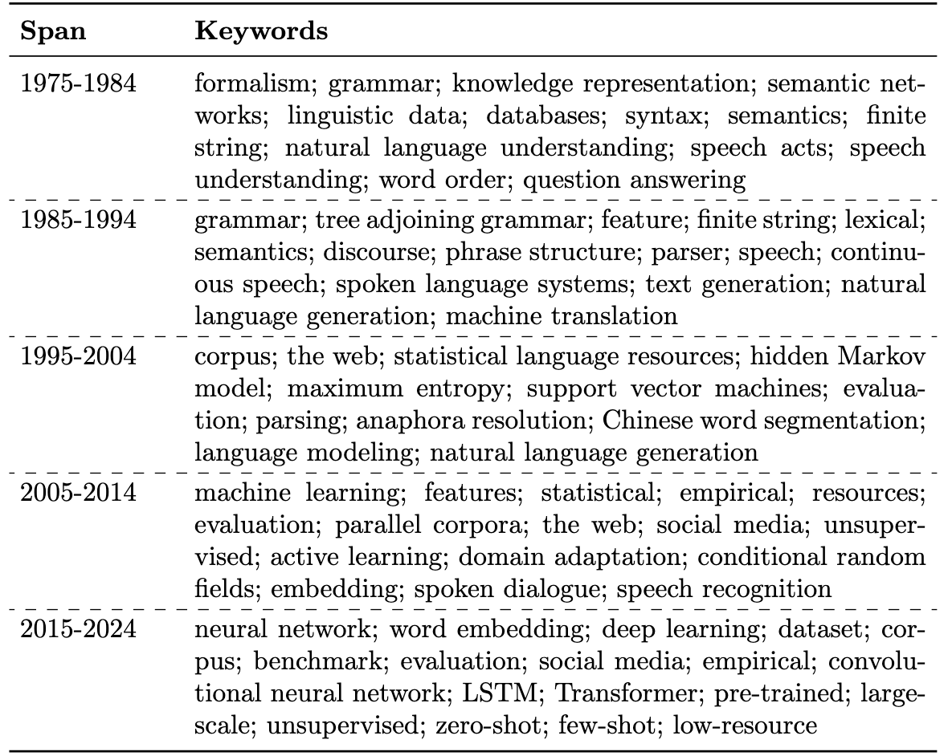
Common keywords in research

Slide 70
NLP from machine learning perspective
NLP tasks are many and dynamically evolving, but fewer according to machine learning nature
Disappearing tasks
Prepositional phase attachment
I eat pizza with fork.
I eat pizza with cherry.
New tasks
Open QA, coding, video generation
Text Summarization
(becomes part of LLM)

Slide 71
NLP from machine learning perspective
NLP tasks are many and dynamically evolving, but fewer according to machine learning nature
Classification
Output is a distinct label from a set
Structure prediction
Outputs are structures with inter-related sub structures
Regression
Output is a real valued number, e.g. predicting stock prices
Generation
Output is text

Slide 72
Summary
What is Natural Language Processing (NLP)
A spectrum of NLP problems
NLP from a machine learning perspective

